Slide 1
Plate tectonic processes continued

Slide 2
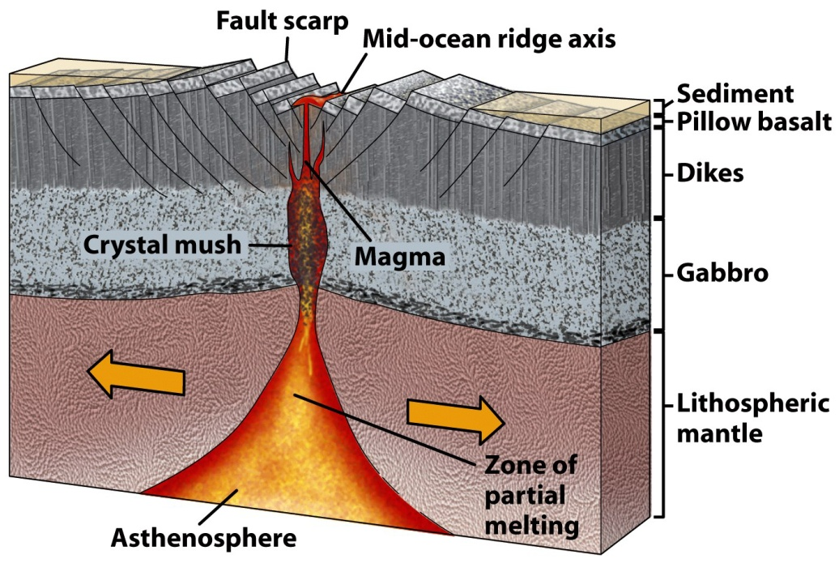
Mid-Ocean Ridges
Magma is created by melting the Asthenosphere as it rises to fill in gap created by sea-floor spreading (decompression melting)
Notes:
Magma from the Asthenosphere rises to fill in gap created by sea-floor spreading – dikes are conduits for magma to flow up to surface – lava pools at surface, cools, and is pulled apart.
Some magma solidifies along the side of the chamber, some erupts as lava at the surface

Slide 3
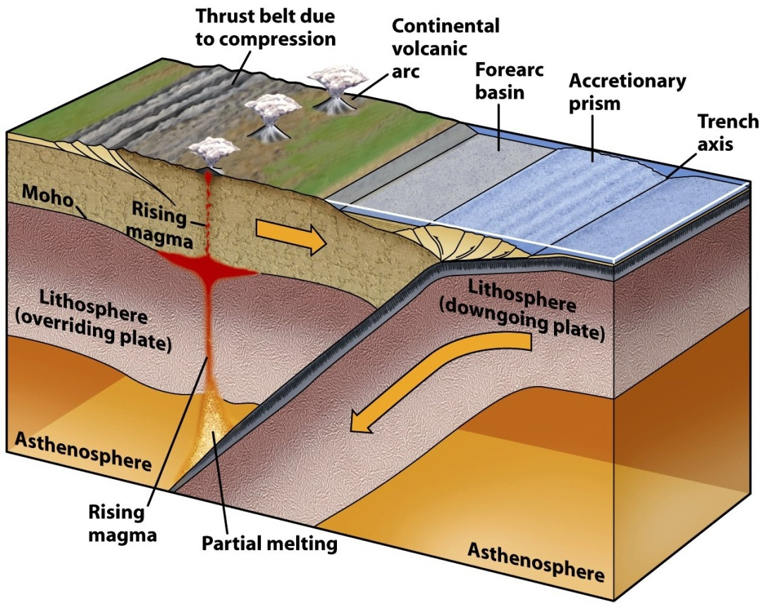
Subduction zones
Volatile-enhanced melting of mantle above the subducting slab
Creates magma chambers and associated volcanoes in the continental crust above

Slide 4
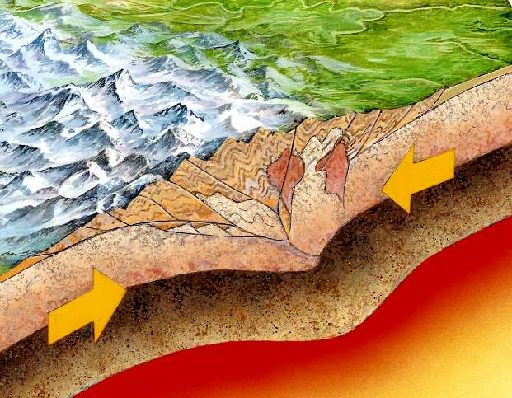
Collisional Zones
Continent-Continent Convergence
No subduction?
High pressure - lots of metamorphism and deformation of crustal rocks

Slide 5
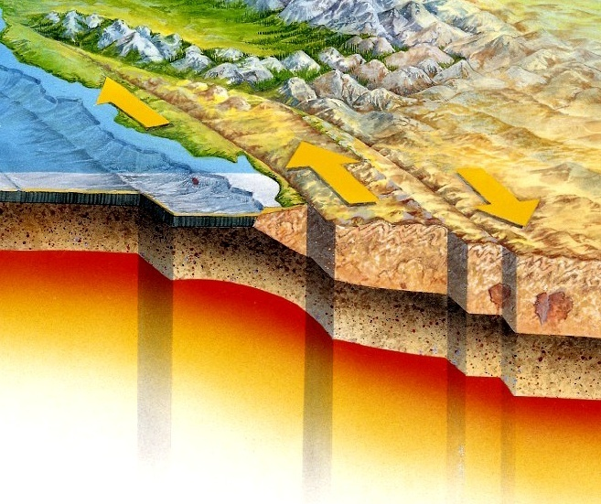
Transform Plate Boundaries
They form a link between two other types of plate boundaries
Plates slide past
No creation/destruction
Continental
Oceanic
Notes:
Draw on board the links?

Slide 6
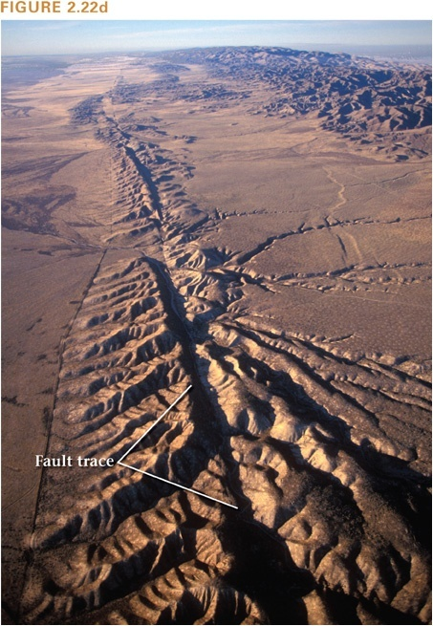
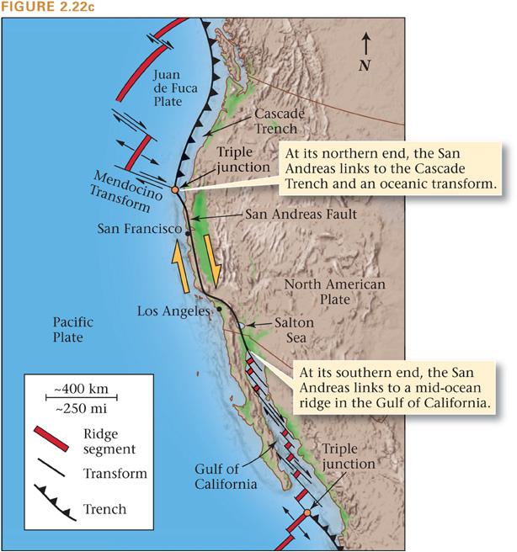
Continental Transforms:
San Andreas Fault, CA

Slide 7
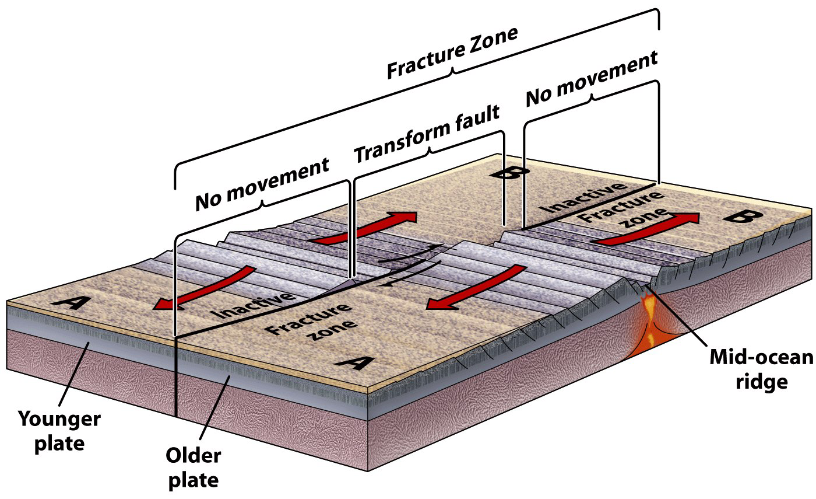
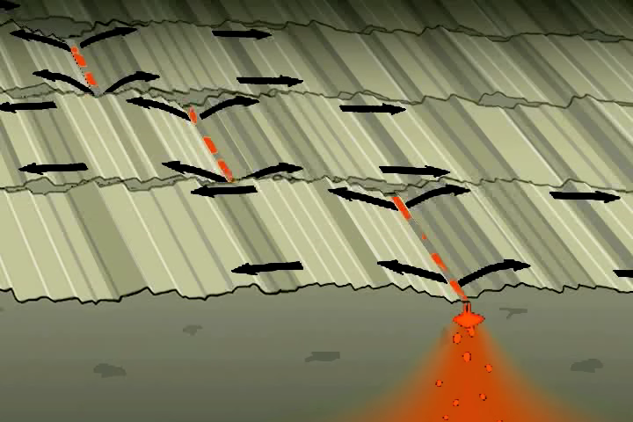
Oceanic Transforms
Courtesy of Tanya Atwater

Slide 8
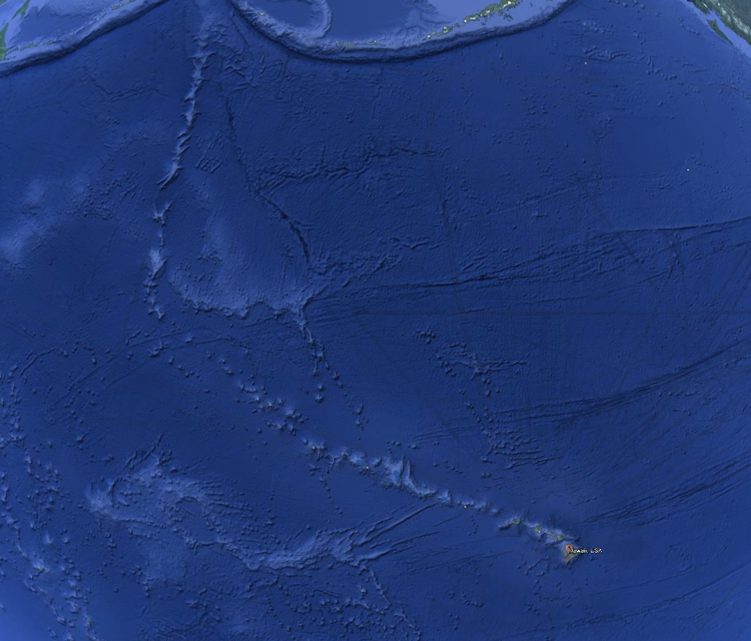
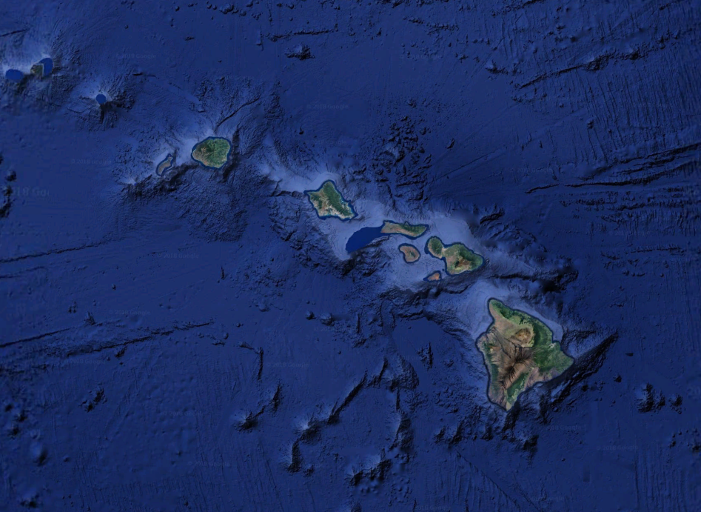
Hot Spots
Volcanoes independent of plates
“intra-plate volcanism”
leave distinct chain of volcanoes

Slide 9
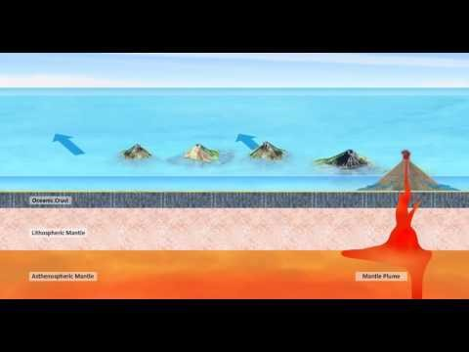
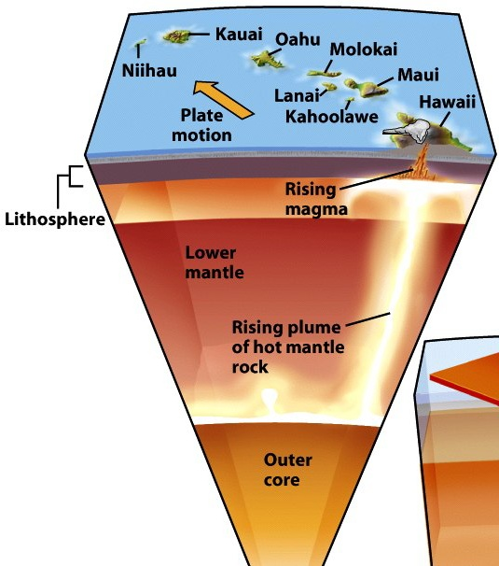
Hot Spots – Mechanism = mantle plume

Slide 10
Rocks and Minerals

Slide 11
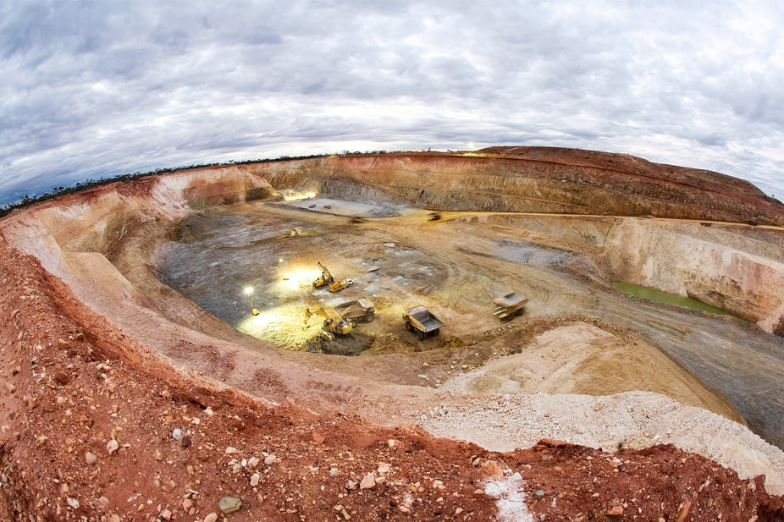
Keep in mind:
Resource distribution is a result of:
Global plate tectonic processes which established major geologic settings and rock types
Local processes that resulted in the formation of resources (e.g. erosion and weathering processes, hydrothermal fluids)

Slide 12
Most Important Resource forming Processes (we will come back to this list)
Deep Subsurface Igneous and Metamorphic processes
Surface Processes
Shallow Subsurface and Diagenetic Processes
Marine processes

Slide 13
Minerals:
What is a mineral?
Notes:
13

Slide 14
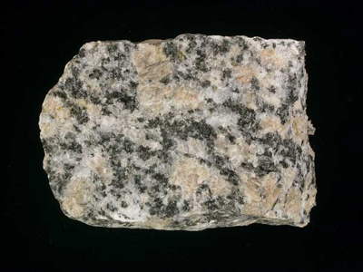
Minerals are the building blocks of rocks Provide clues about rock’s history Some minerals contain valuable elements

Slide 15
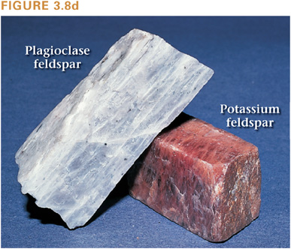
Mineral Definition
1) Naturally occurring
2) Inorganic
3) Solid
4) Specific chemical composition
5) Crystalline Structure

Slide 16
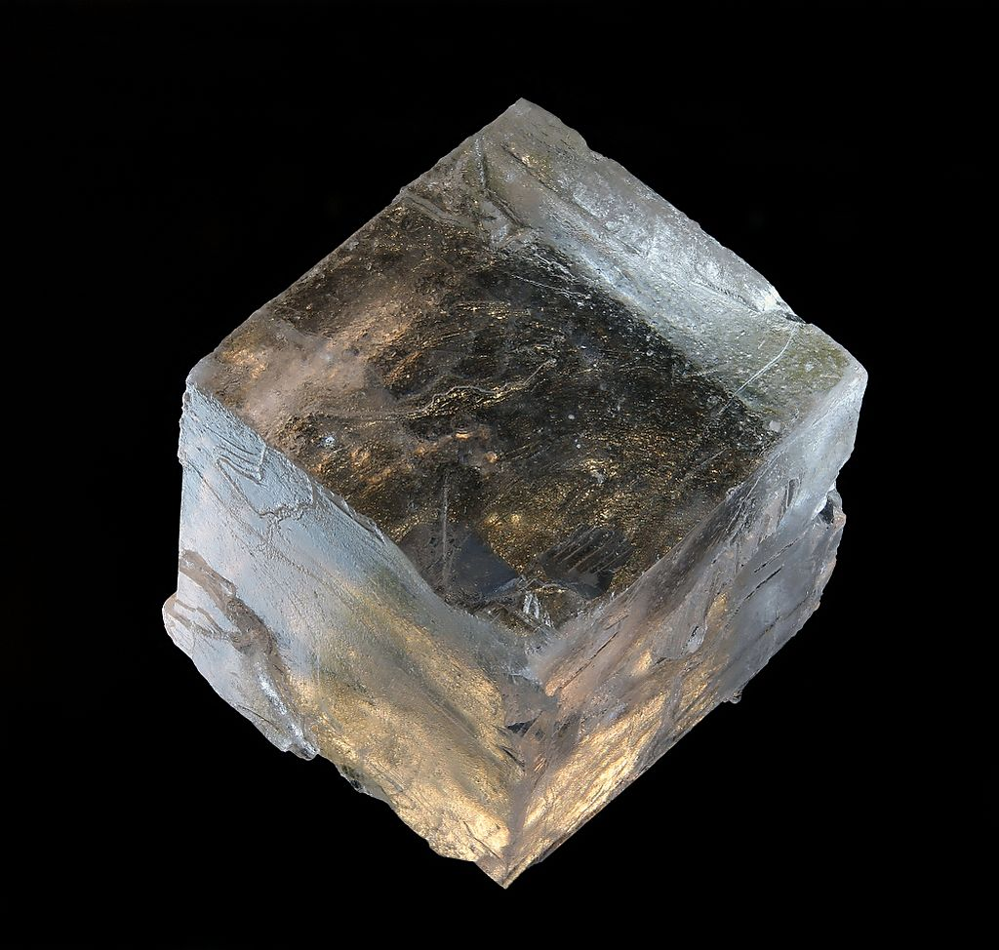
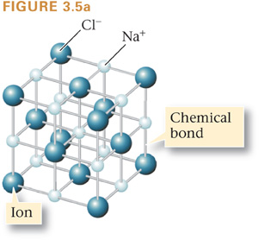
Mineral Definition
1) Naturally occurring
2) Inorganic
3) Solid
4) Specific chemical composition
5) Crystalline Structure
Chemical composition of halite: NaCl
Notes:
Go through the checklist for this salt example

Slide 17
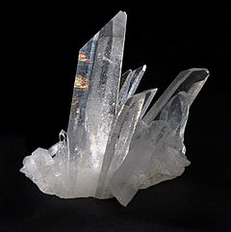
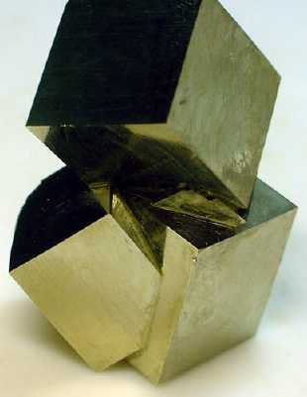
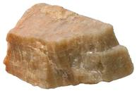
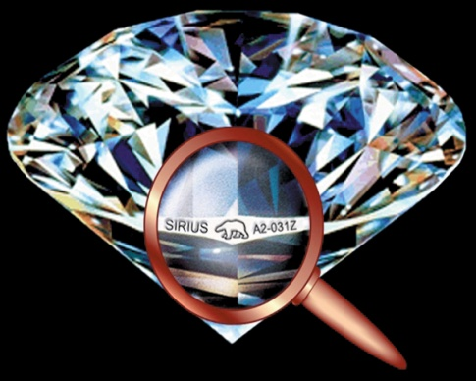
Specific chemical composition: Each mineral has a chemical formula:
Potassium feldspar (KAlSi₃O₈)
Pyrite (FeS₂)
Quartz (SiO₂)
Diamond (C)

Slide 18
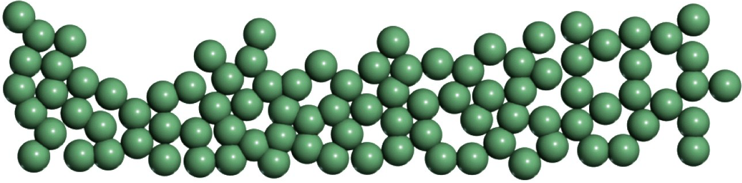
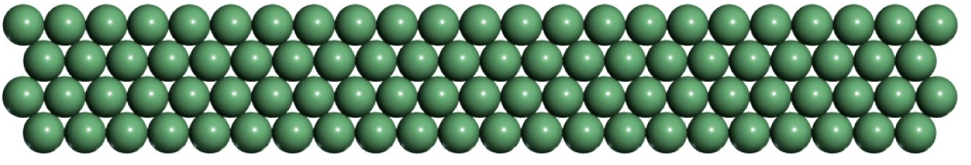
Crystalline structure:
Non-crystalline structure (atoms randomly arranged)
Crystalline structure (atoms have ordered microscopic structure; order is repeated in all directions (lattice))

Slide 19
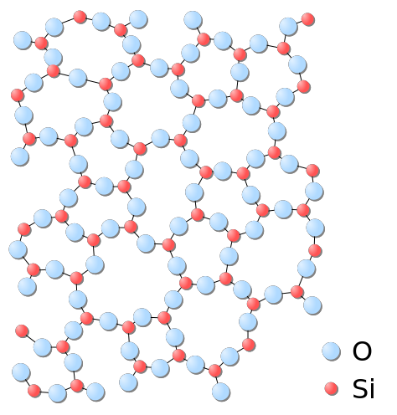

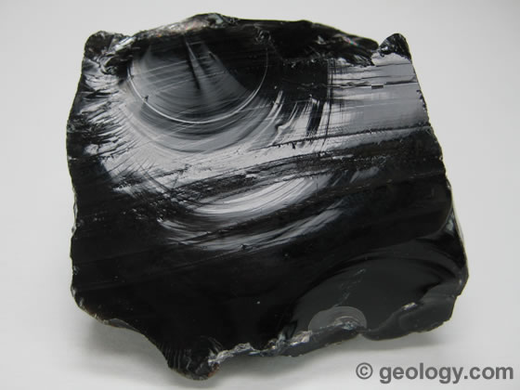
Solids without crystalline structure
a.k.a. ‘glass’
No crystalline structure = amorphous
Glass
Glassy silica
Volcanic glass (obsidian)
Notes:
This has a definite chemical composition, but it is not a mineral. Why not?

Slide 20
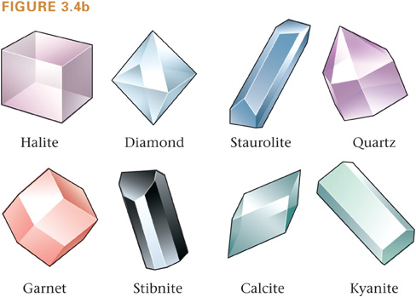
A crystal is a single continuous piece of a mineral.

Slide 21
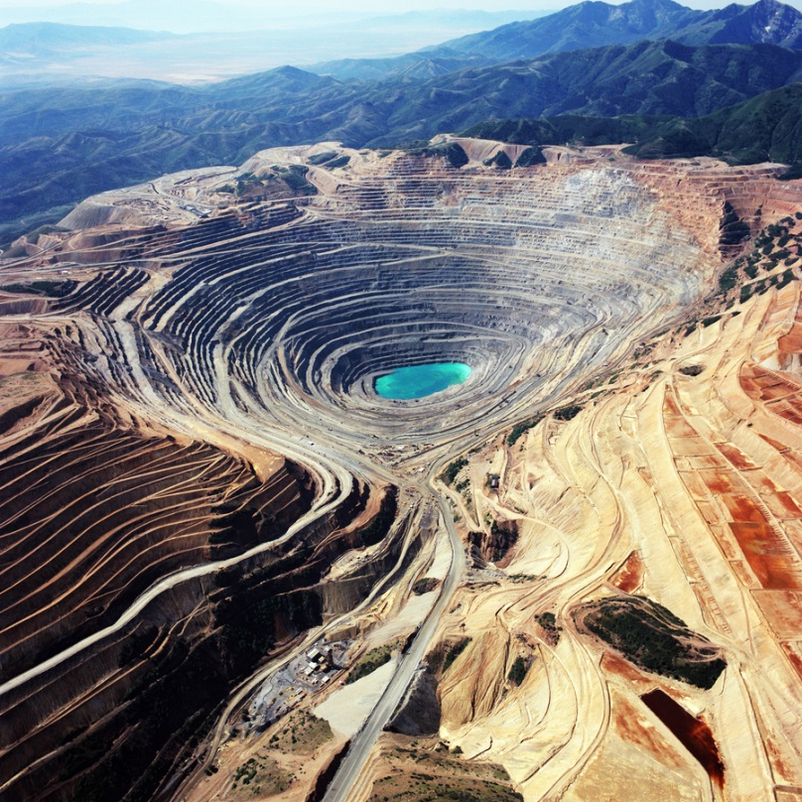
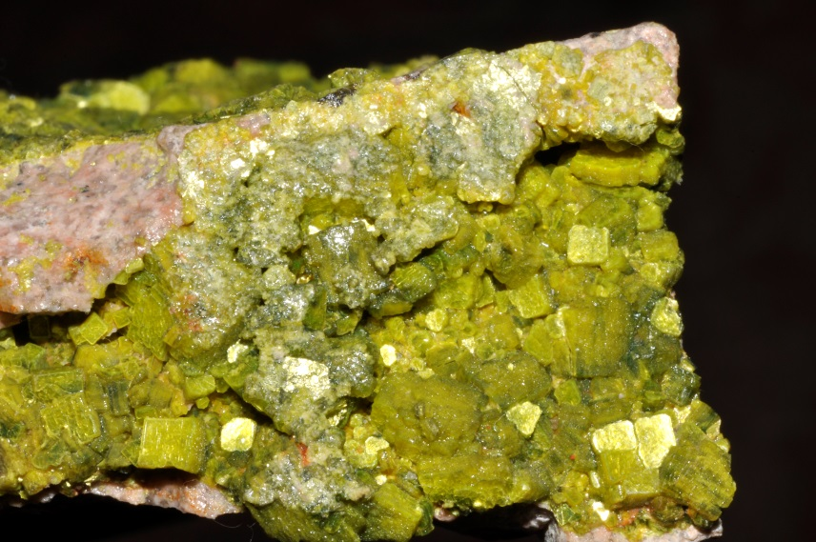
Why do we care about minerals?
Make up rocks and sediments
Minerals are the host of the valuable elements we seek to mine
Environmental Hazards

Slide 22
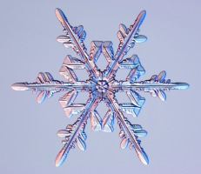
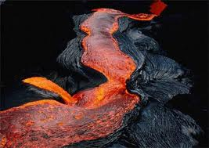
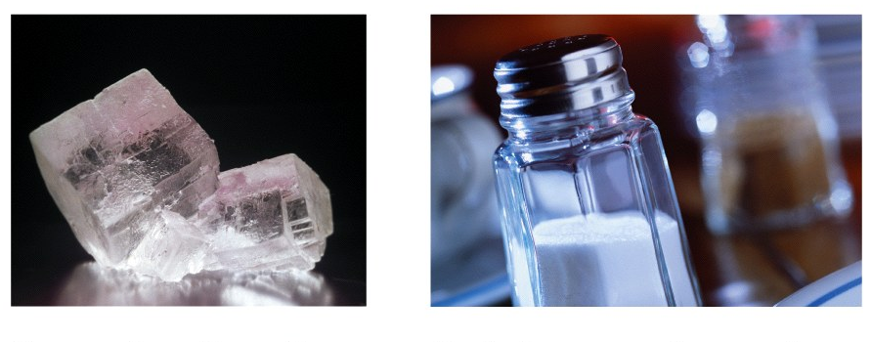
Formation of Minerals
Five primary ways they form:
Solidification of a melt
= freezing out of a liquid
Precipitation from solution

Slide 23
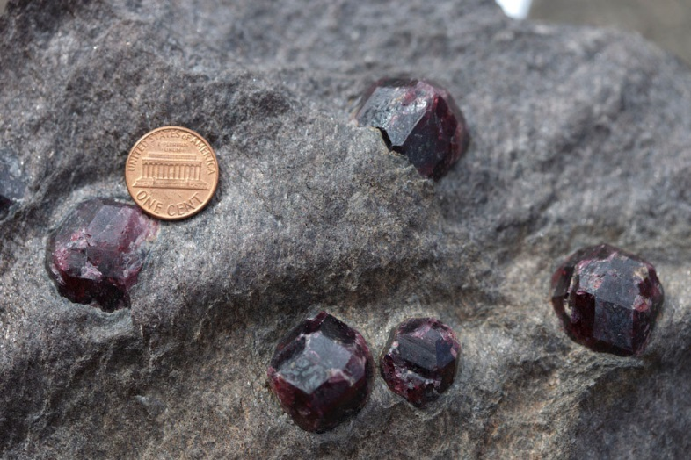
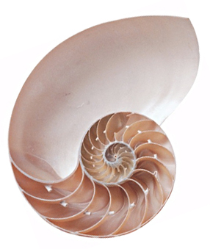
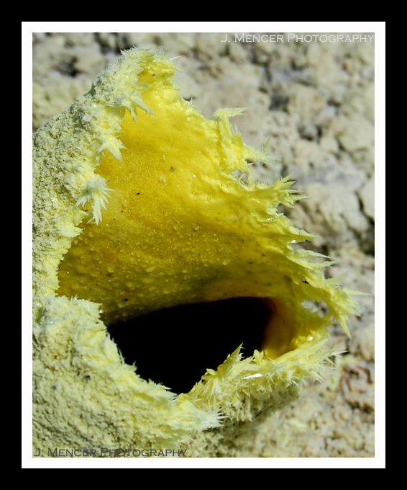
Formation of Crystals
Solid state diffusion (Metamorphism)
Biomineralization
Precipitate from gas

Slide 24
Minerals:
Classifying minerals
Notes:
24

Slide 25
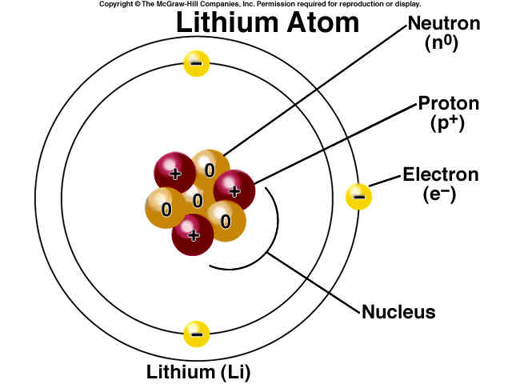
Atoms
Protons: positively charged
Neutrons: electrically neutral
Electrons: negatively charged

Slide 26
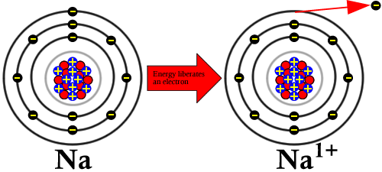
Ions
Atoms can
gain electrons to become negatively charged anions, or
lose electrons to become positively charged cations

Slide 27
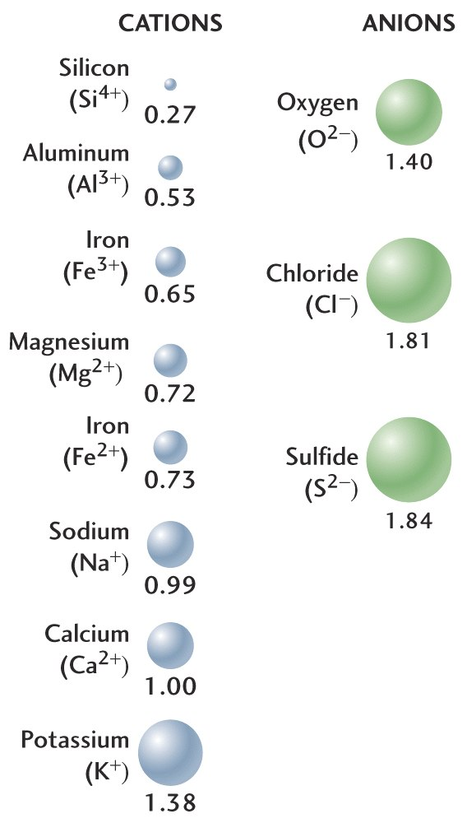
Minerals are classified based on the dominant anion.
A few examples of cations and anions commonly in minerals

Slide 28
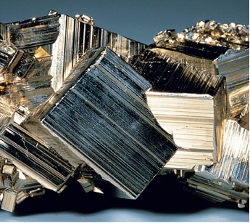
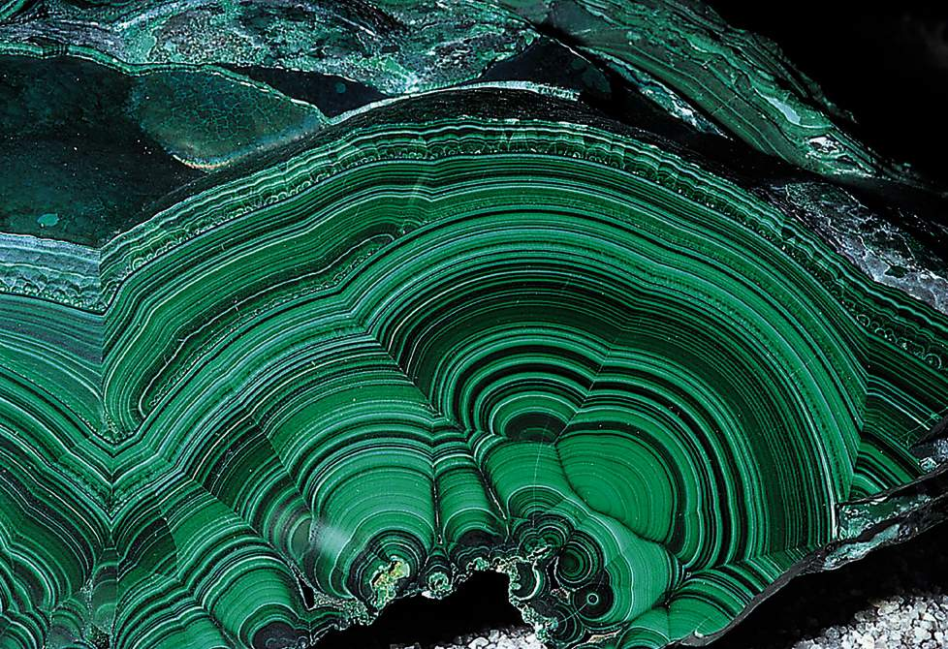
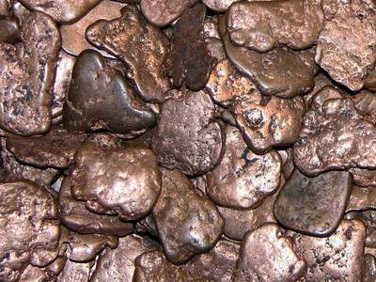
A few important mineral classes
Silicates SiO₄⁴⁻ Rock-forming minerals
Sulfides S⁻ Pyrite, Galena
Carbonates CO₃²⁻ Calcite, Dolomite
Native elements (no anions) Copper, Gold, Graphite
Oxides/hydroxides O²⁻ Hematite, magnetite
Sulfates SO₄²⁻ Barite, Gypsum
Halides a halogen (eg. F⁻, Cl⁻) Halite, fluorite
Phosphates PO₄³⁻ Apatite, monazite
Pyrite (Sulfide)
Malachite (Carbonate)
Native Copper (Native elements)

Slide 29
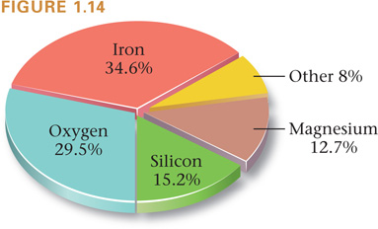
The proportion of major elements making up Earth
Earth is composed of:

Slide 30
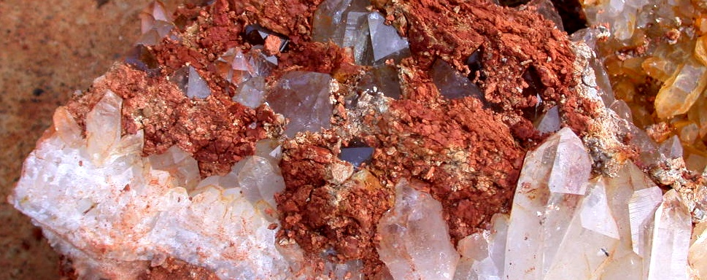
Silicate Minerals
Silicates are “the rock-forming minerals.”
Make up >95% of continental crust. E.g., quartz

Slide 31
Rocks
Notes:
31

Slide 32
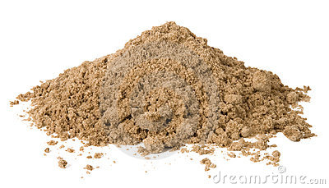
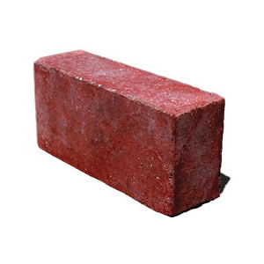
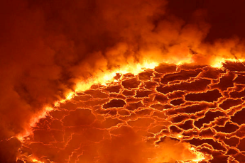
What is a rock?
Rocks are coherent, naturally occurring solids consisting of an aggregate of minerals or (less commonly) a mass of glass
Coherent
Naturally occurring
Solid
Not a rock
Not a rock
Not a rock

Slide 33
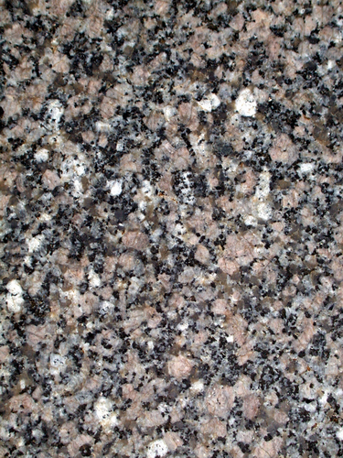
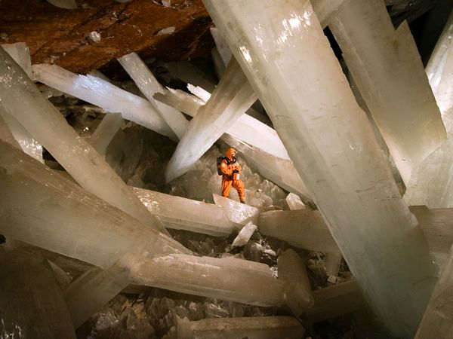
What is a rock?
Rocks are coherent, naturally occurring solid consisting of an aggregate of minerals or (less commonly) a mass of glass
Aggregate of minerals ….
Not a rock
Rock

Slide 34
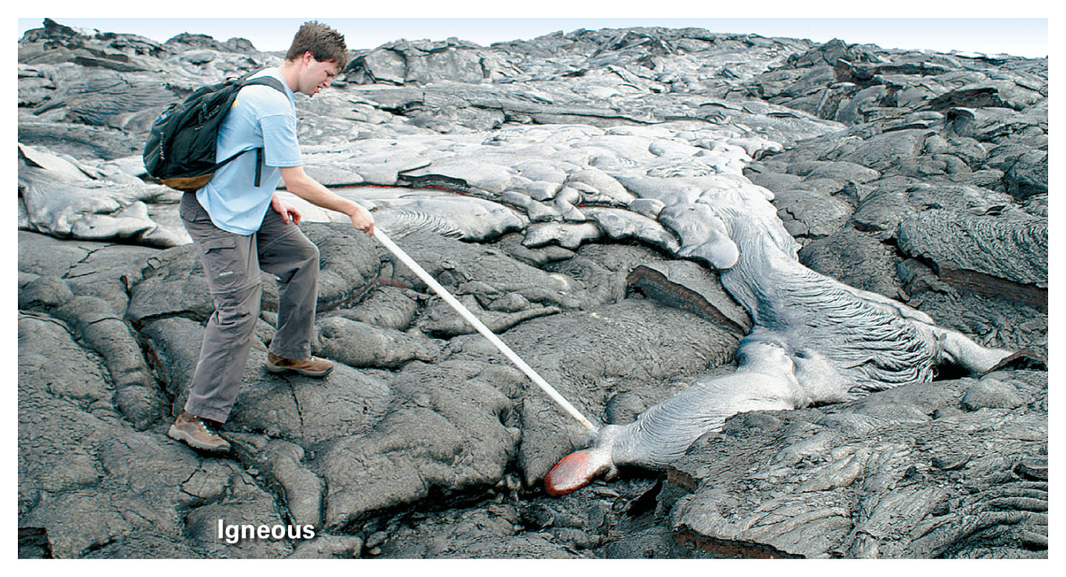
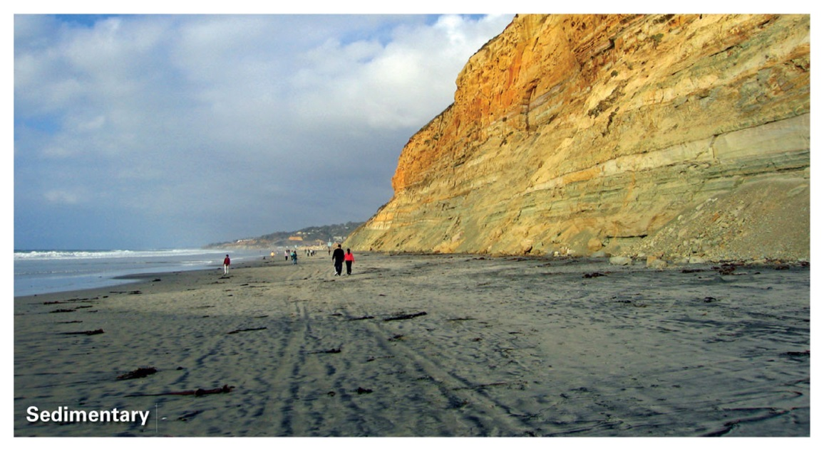
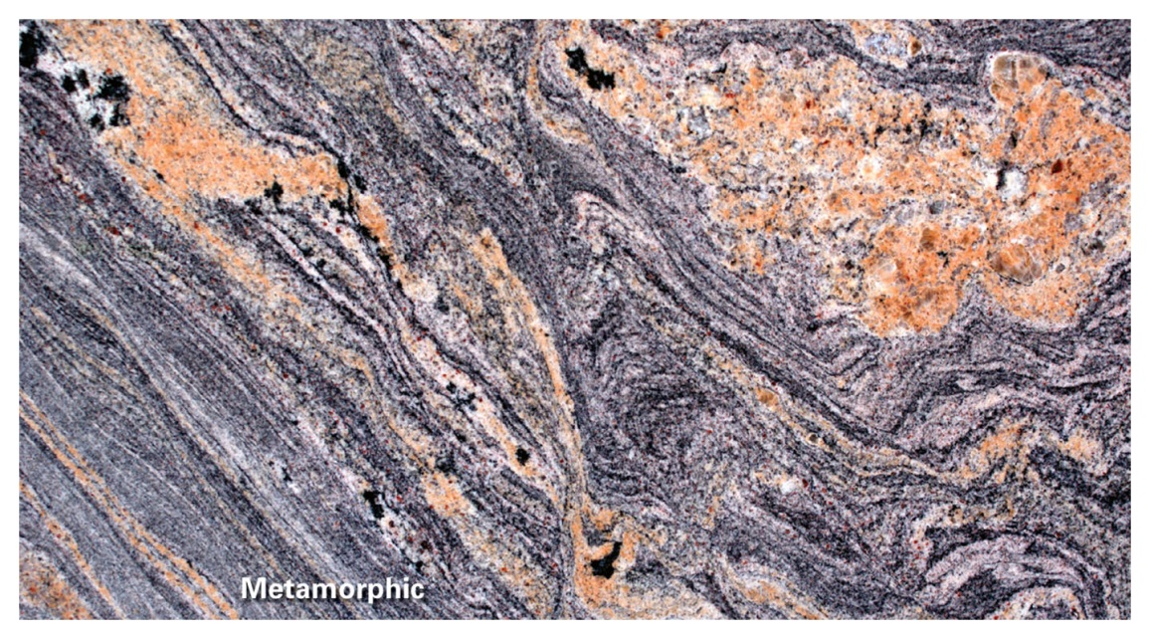
Igneous
Sedimentary
Metamorphic

Slide 35




Igneous rocks
Slow cooling – coarse grained
granite
Cooling
Magma
fast cooling – fine grained
basalt

Slide 36

Weathering & erosion
Deposition
Sediments
Burial & lithification
Sedimentary
rocks
Navajo sandstone

Slide 37

Or : Precipitation out of water
Sedimentary
rocks
Limestone

Slide 38


*Solid-state transformation, i.e. NO MELTING
Sedimentary
rocks
Igneous rocks
heat & pressure
heat &
pressure
gneiss
Metamorphic
rocks
schist

